Slide 1
Virtual Machine Scaling Method considering performance fluctuation of Public Cloud
Instructor:-
Dr. Isha Pathak Tripathi
By:-
Ayush Sharma (2016KUCP1027)
Devesh Gaur (2016KUCP1029)
Rajesh Kumar (2016KUCP1040)
INDIAN INSTITUTE OF INFORMATION TECHNOLOGY, KOTA

Slide 2

One of the factors
that degrades performance stability of applications running in the cloud is “unexpected loads”, caused by interference between Virtual Machines (VMs) coexisting on the same physical machine.
Efficient Virtual Machine utilization.
Cost Optimization.

Slide 3
Objective
We propose a VM scaling method that forecasts
performance fluctuation caused by unexpected loads to adjust
the number of VMs appropriately.

Slide 4
Cloud Computing
Makes computer system resources,
especially storage and computing power,
available on demand without direct active management by the user.
Creation of Virtual Machines
Reduction of cost of hardware
No need to carry any hardware.
The Largest public cloud - Amazon AWS.

Slide 5


Use of AWS in Our Project
Creation of VMs – AWS EC2 Server
Load Balancer – AWS ELB
Virtual Manager – AWS Cloud Watch
Apart from this-
MQTT Broker

Slide 6
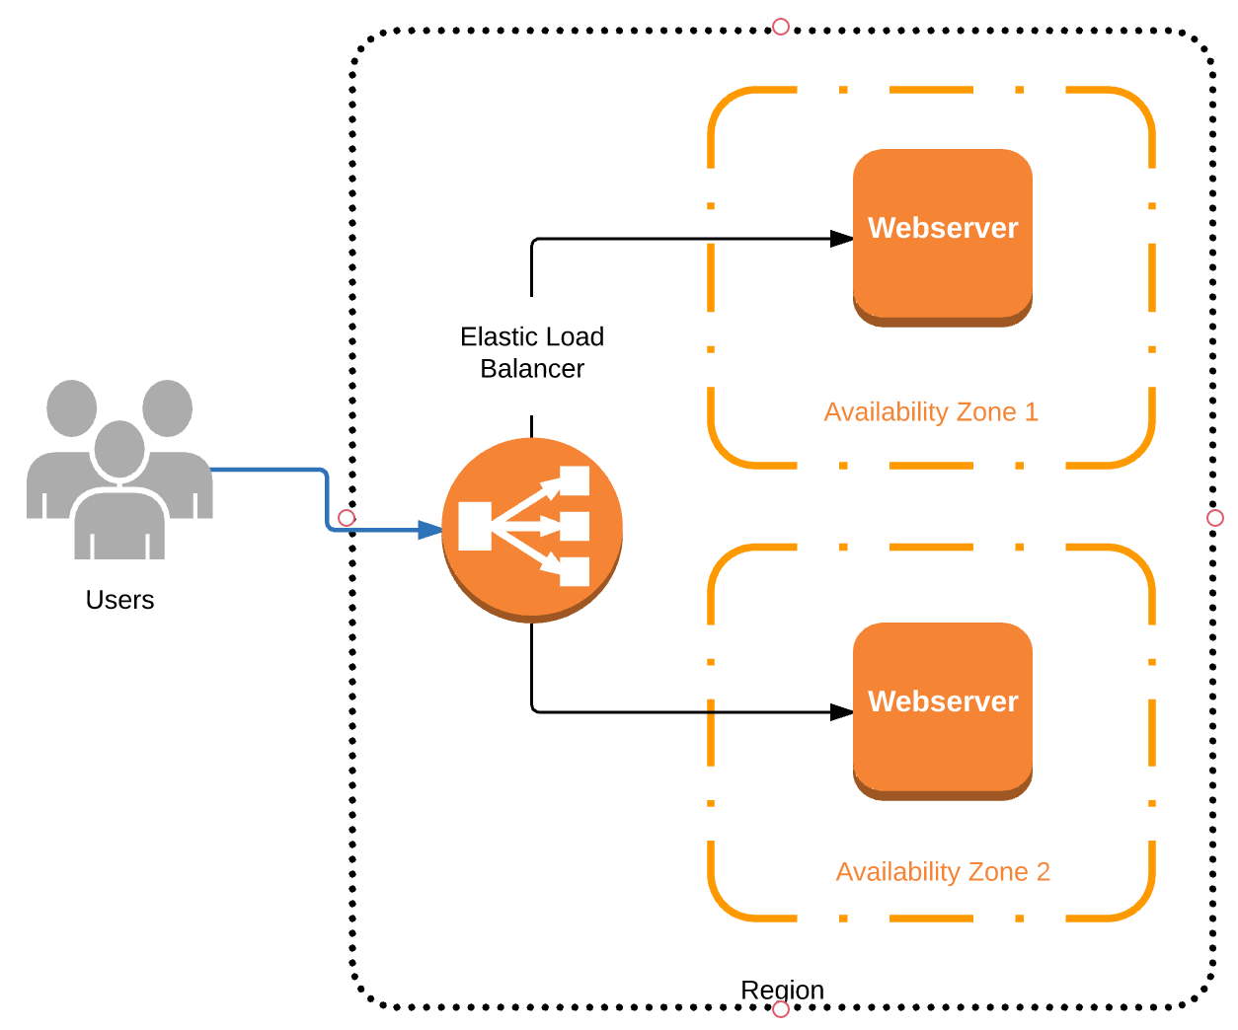
Elastic Load Balancer
Fig: Functioning of AWS ELB

Slide 7
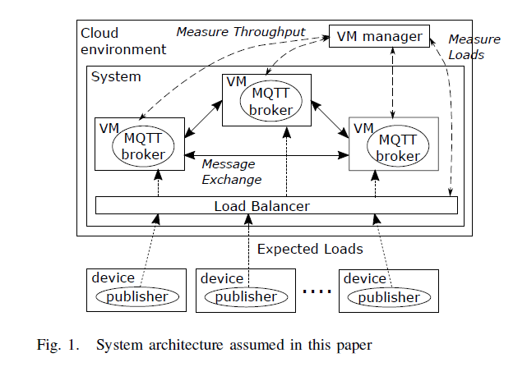
System Architecture Assumed

Slide 8








Mathematics behind Algorithm
Where,
is the amount of unexpected performance fluctuation at time t for VM(i).
is the expected load at time t distributed for VM(i).
denotes performance of VM(i), affected only expected load
denotes that measured performance of VM(i) at t.
is future performance.

Slide 9
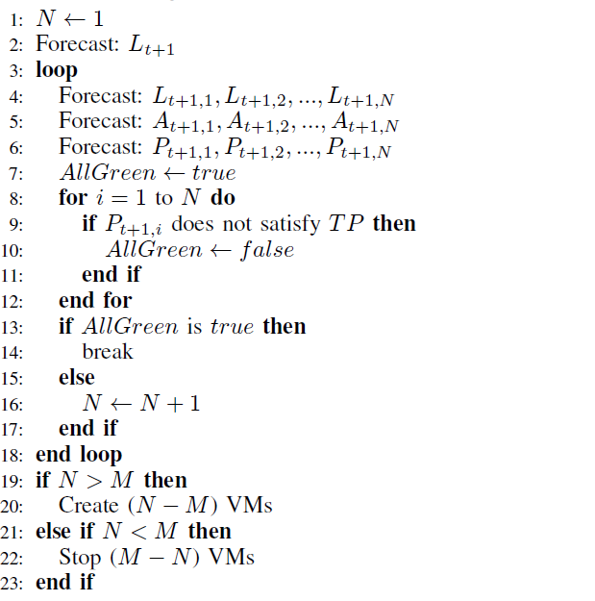
Algorithm
Fig: Algorithm from research paper.

Slide 10
Conclusion
We proposed a VM scaling method that forecasts the
unexpected performance fluctuation to adjust the number of
VMs.

Slide 11
References
2017 IEEE 10th International Conference on Cloud Computing
Virtual Machine Scaling Method Considering Performance Fluctuation of Public Cloud
by:-Yu Kaneko, Toshio Ito, Masashi Ito, Hiroshi Kawazoe
Corporate Research and Development Center, Toshiba Corporation
Email: {yu1.kaneko, toshio9.ito, masashi8.ito, hiroshi.kawazoe}@toshiba.co.jp

Slide 12
Thank You

